Slide 1

Book Rating Prediction using Recommender Systems for goodreads.com CSE 6240 Course Project Spring 2022 (Team 5)

Slide 2

Agenda
Introduction
Dataset Description
Experimental Setup
Methods
Results Summary
Future Steps

Slide 3
Introduction
Motivation:
Ability to provide good and accurate recommendations that pique the interest of the consumers can have a significant impact on
increasing the popularity of reading as a recreational activity
motivating authors to write more books
helping businesses meet their growth targets by improving sales.
Objective:
The goal of the project is to build a recommender system for books using multiple approaches in collaborative filtering.
We have used the Goodreads dataset containing books related to the genre “Poetry”

Slide 4
Dataset Description
Source: Goodreads dataset containing books related to the genre Poetry
Datasets:
books metadata
user-book interactions (shelves)
reviews data
Goodreads (Poetry Genre) | Statistics
Books | 36514
Shelves (Interactions) | 2,734,350
Ratings | 1,229,059
Reviews | 155,414
Shelves per book | 74.88
Shelves per user | 7.24
Ratings per book | 33.66
Ratings per user | 3.25
Reviews per book | 4.26
Reviews per user | 0.41
Pre-processing:
Combined interactions and reviews to get ratings per book per user
Filtered out fraud reviews and keeping only legitimate ratings.
In case of updates, we have taken the last given rating.

Slide 5
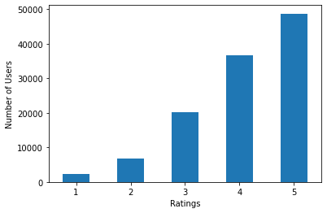
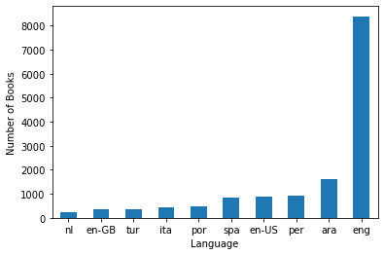
Dataset Description
The datasets were collected in late 2017 from goodreads.com by scraping users' public shelves.
User IDs and review IDs were anonymized to maintain privacy
The ratings scale in the dataset is 1 - 5
The dataset spans multiple languages as seen in the figure

Slide 6
Experimental Setup
We worked on books, reviews, and user interactions data obtained from the Goodreads dataset for books related to the poetry genre.
Our goal is to predict the prospective ratings of unread books for a user.
For these purposes, we divided the data into training and test sets with a split ratio of 80:20.
We then evaluate our model using MSE (Mean Square Error) and MAE (Mean Absolute Error) in the prediction of book-rating in test data.

Slide 7
Methods
Item-Item Collaborative Filtering
Neural Collaborative Filtering
Wide and Deep Learning for Recommender Systems
NCF with Matrix Factorization
Neural Matrix Factorization
NeuMF with book genres

Slide 8
Method I: Item-Item CF
Based on the similarity between items calculated using people's ratings of those items via the user-item rating matrix
Split data into train and test such that books with only one rating instance were present only in training set. Selected one book-rating at random for books with multiple ratings were selected for test set. Obtained 90:10 split.
Used weighted cosine similarity average between books to predict prospective rating.
Directly utilizes ratings given by readers to books
This method serves adequately as a baseline from which we can compare our more complicated models.
 | MAE (L1) | MSE (L2)
Item-Item CF | 2.8516 | 11.5179

Slide 9
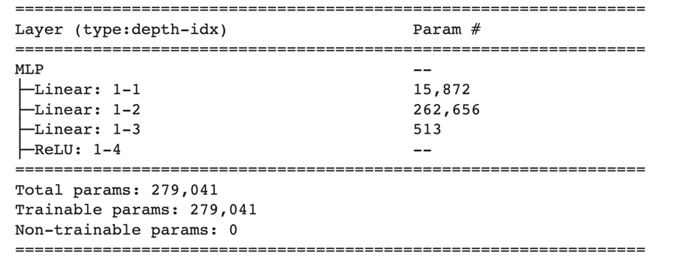
Method II: NCF w/ Matrix Factorization
Used user-item rating adjacency matrix factorization to create reader and book embeddings.
Fed generated embeddings as inputs to Multi-Layered Perceptron (MLP) network.
Evaluated on test data (80:20 split) using MSE and MAE metrics.
 | MAE (L1) | MSE (L2)
Matrix Factorization (NCF) | 0.97 | 1.426

Slide 10
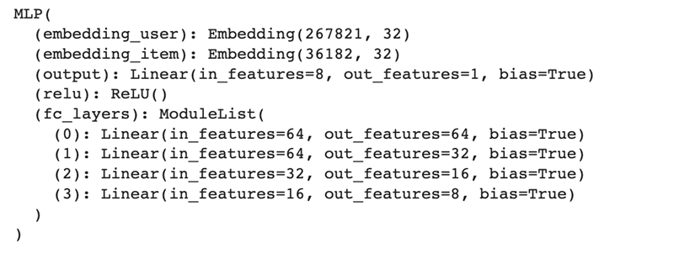
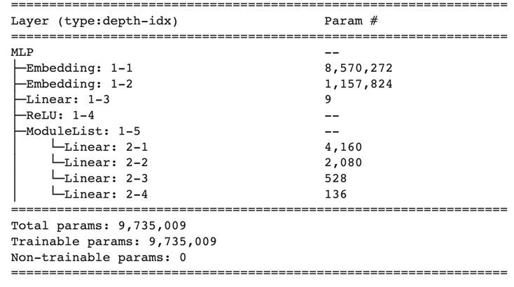
Method II: Neural Matrix Factorization
Included an embedding layer as part of the neural network model and trained it using batch-wise gradient.
Ensured better embeddings as compared to previous models which are trained dynamically through loss optimization.
 | MAE (L1) | MSE (L2)
NeuMF | 0.784 | 1.002

Slide 11
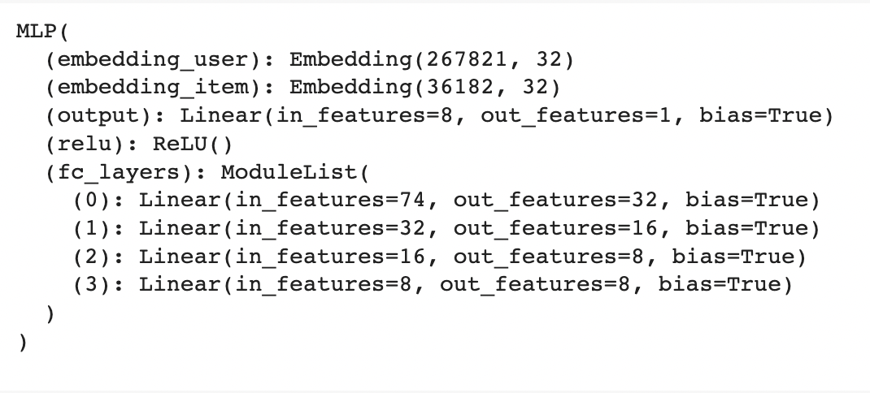
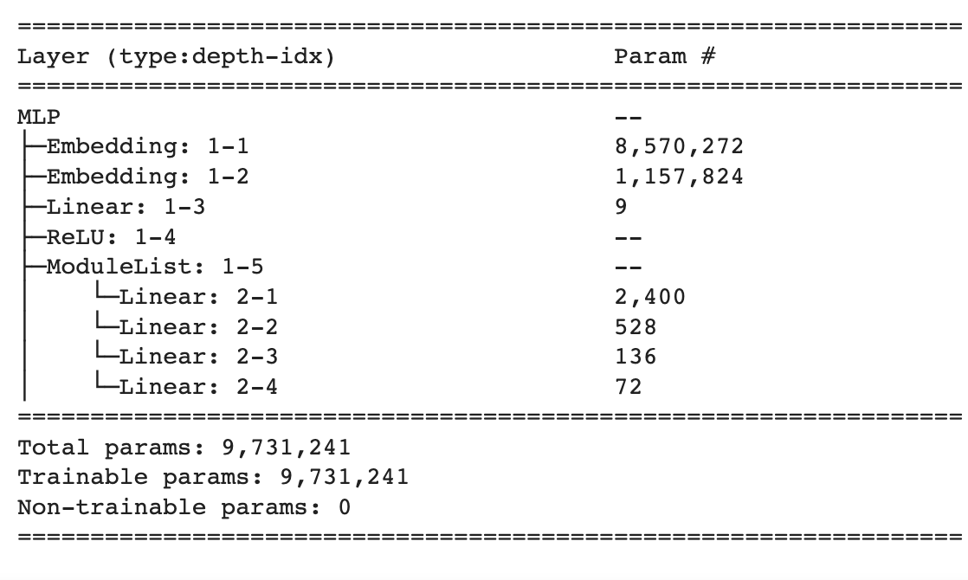
Method II: Neural MF w/ Book Genres
The genre feature captures the number of users who tagged the book as belonging to a certain genre.
Improved on our initial NeuMF implementation by including genre information as part of the input to be passed in MLP architecture to generate embeddings
 | MAE (L1) | MSE (L2)
NeuMF w/ Book Genre | 0.779 | 0.964

Slide 12
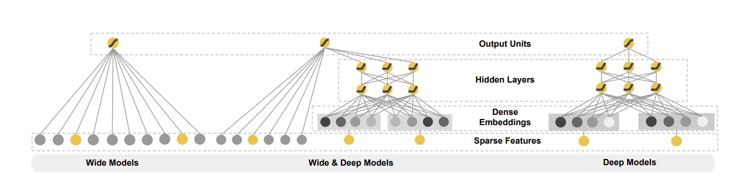
Method III: Wide & Deep Learning
The Wide & Deep learning framework jointly trains a feed-forward neural network with embeddings (the deep component) and a linear model with non-linear transformations (the wide component).
The wide component is a generalized linear model which uses cross-product transformed user and item one-hot vector as its feature set.
The deep component uses the high-dimensional user and item features ( the one-hot vectors) and converts them into a low-dimensional and dense real-valued vector, often referred to as an embedding vector.

Slide 13
Method III: Wide & Deep Learning
Model Framework | Wide Model | Deep Model
Feature Set | User & item one-hot vectors | Deep, low dimensional embedding for each user and item Book genre feature (size = 10)
Hyperparameters | Adagrad optimizer Learning rate = 0.0621 | Adagrad optimizer Learning rate = 0.1 Hidden units = [512, 128, 64] Dropout rate = 0.8 User emb vector size = 32 Item emb vector size = 16
 | MAE (L1) | MSE (L2)
Wide & Deep Model | 0.717 | 0.774

Slide 14
Results Summary
The results summary for each model implemented shown below
The Item-Item CF model had the poorest performance as expected at 11.51 MSE. This model serves as a baseline to improve upon
The NCF model show significant improvement from the Item-Item CF model.
Best model performance was obtained through the Wide and Deep Learning framework giving a minimum MSE of 0.774
Model | MAE (L1) | MSE (L2)
Item-Item CF (baseline) | 2.8516 | 11.5179
Matrix Factorization (NCF) | 0.97 | 1.426
NeuMF (NCF) | 0.784 | 1.002
NeuMF w/ Book Genre (NCF) | 0.779 | 0.964
Wide & Deep Model | 0.717 | 0.774
14

Slide 15
Future Steps
Create embeddings using methods such as node2-vec to leverage book-reader graph structural information
Use BERT to include book metadata and descriptions along with reader’s browsing behaviors to further amplify level of details and create richer embeddings
15

Slide 16
Thank You

